Slide 1

School of Computing Science and Engineering
Course Code: E2UC201C Course Name: OOPs with C++
Login and Registration System in C++
Sujal Rathor (22SCSE1011245)
Md Ehtesham Hussain (22SCSE1011284)

Slide 2
Introduction
Welcome to our project on login and registration system in C++!
In today's digital world, it is important to secure personal information and restrict unauthorized access to sensitive data. In order to accomplish this, login and registration systems are widely used in software applications.
This project aims to develop a simple and efficient login and registration system using C++. The project will include user registration, account creation, and user login.
This project is not only a great opportunity to learn about C++ programming, but also to gain knowledge and experience in building a fundamental security system for software applications. Let's dive into the project and create a secure login and registration system in C++!

Slide 3
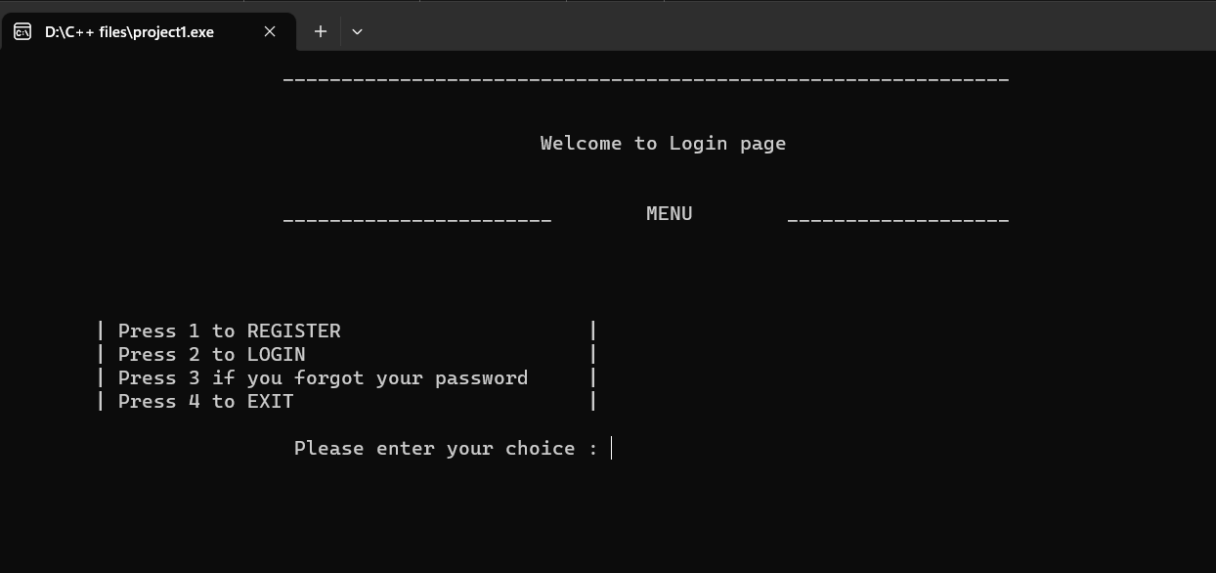
Program Menu
1.Registration​
2.Login
3.Forget password
4.Exit​

Slide 4
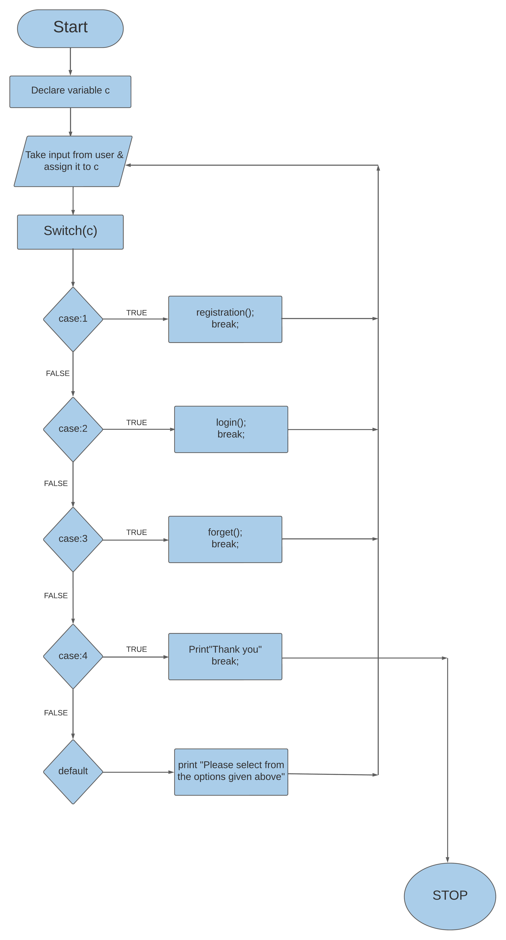
Flow Chart

Slide 5
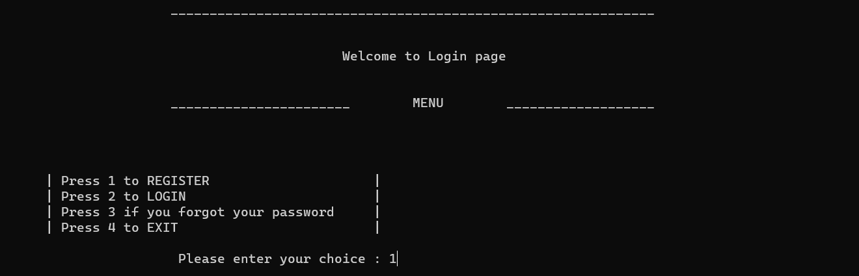


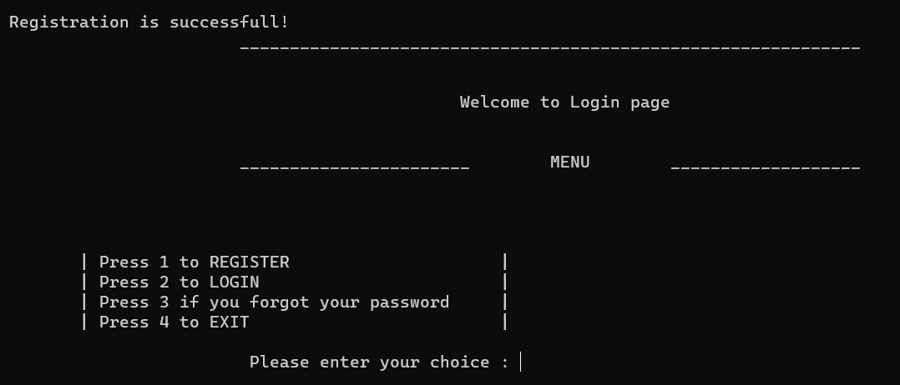
Expected Output
1. REGISTRATION

Slide 6
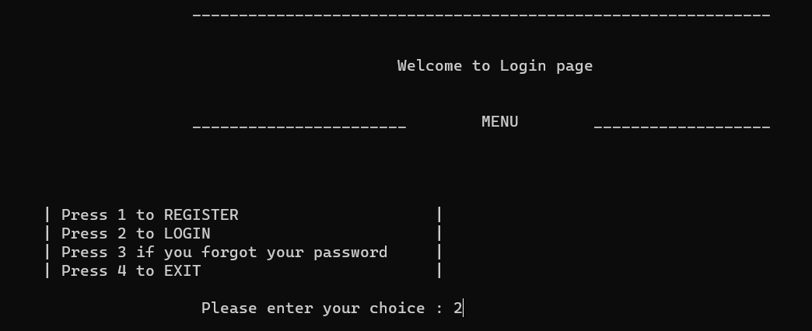

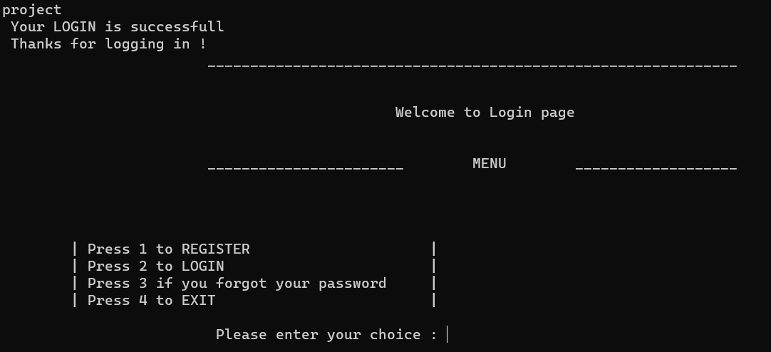
Expected Output
2.LOGIN

Slide 7
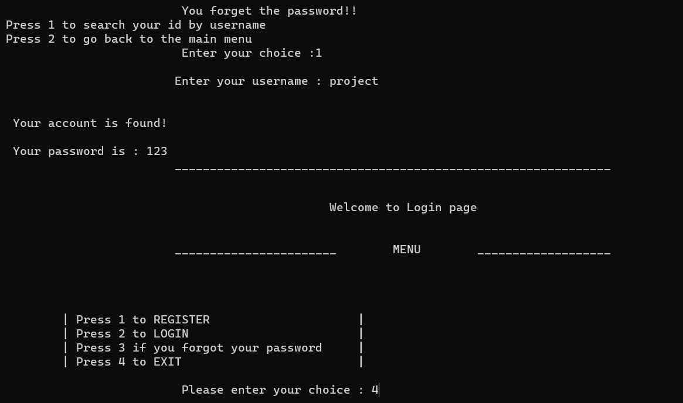
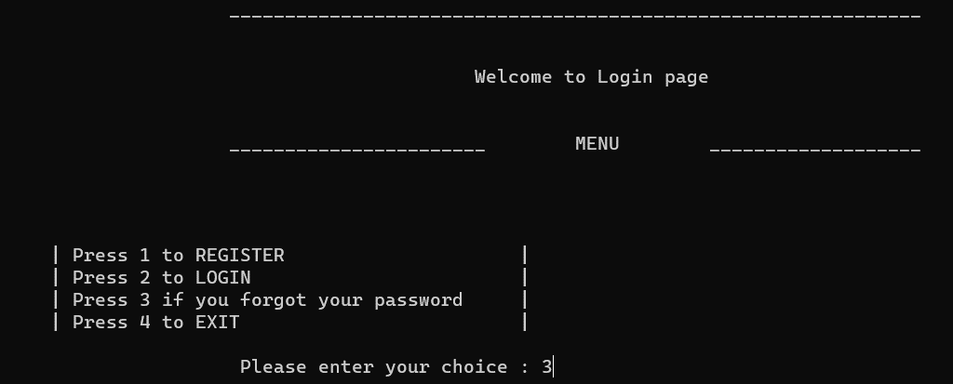
Expected Output
3.FORGOT PASSWORD
EXIT

Slide 8
Conclusion
In this project module, we explored The Login & Registration System program in C++. We learned how to implement Class, Object, if-else and switch and created login system for security and privacy for a user. With this knowledge we can create more complex projects which can help in banking purposes etc.
A secure and user-friendly Login and Registration System in C++ can be designed and implemented by considering the necessary components such as user interface design, server-side validation, password encryption, user authentication, and user authorization.

Slide 9


